Slide 1
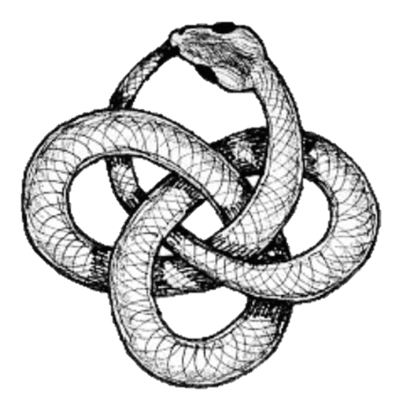
Pyrrhonism vs. Coherentism
Kareem Khalifa Philosophy Department Middlebury College

Slide 2
Overview
Background
BonJour’s Coherentism
Fogelin’s Objections

Slide 3
1. Background
1.1. Fogelin’s characterization
1.2. Narrowing the field

Slide 4
2. BonJour’s Coherentism
2.1. Three central theses
2.2. Standards of coherence
2.3. Justification

Slide 5
3. Fogelin’s Objections
3.1. Utopianism
3.2. DP
3.3. Observation
3.4. Multiple choice
3.5. Truth

